Slide 1
SimpleVLE
SIMPLISTECH LLC
This tutorial will show you how to link your Zoom account with SimpleVLE and create meetings and/or webinars to which you can invite your students.
Zoom Integration

Slide 2
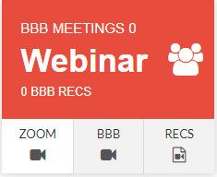
Authorization
In order to use your Zoom account with SimpleVLE, you must first authorize access to your account:
Click
Zoom
Authorize SimpleVLE To:
View all user information
View account info
View all user meetings
View and manage all user meetings
View all user Webinars
View and manage all user Webinars

Slide 3
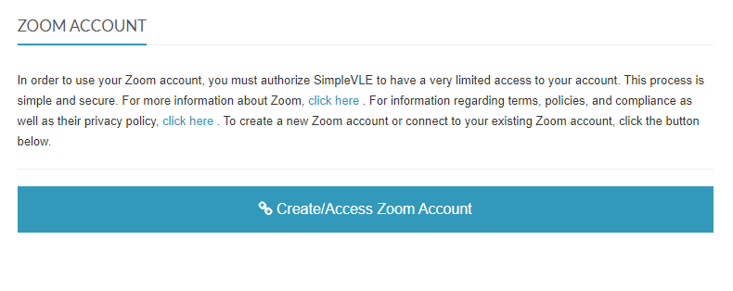
Authorization
Continued...
If you already have a Zoom account, you will just be prompted to login and authorize your account. However, if you do not already have Zoom account, you will have to sign up through Zoom. After signing up with Zoom, you can return to this page and resume the process.
Click
Create/Access Zoom Account

Slide 4
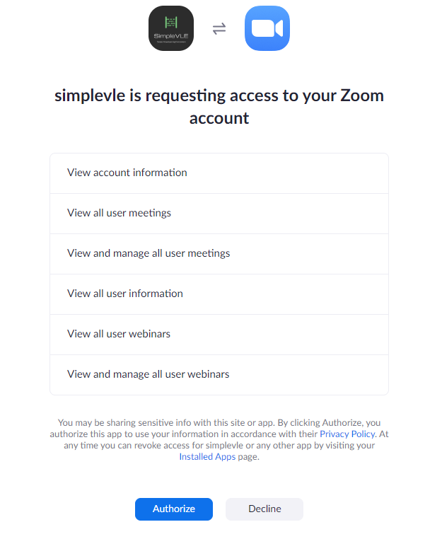
Authorization
Continued...
If you are already logged into Zoom, you will immediately see this authorization screen. Otherwise, you will be prompted to login to Zoom, then you will see it after signing in. This is where you officially authorize SimpleVLE to access your account in adherence to the scopes that are identified on this screen.

Slide 5
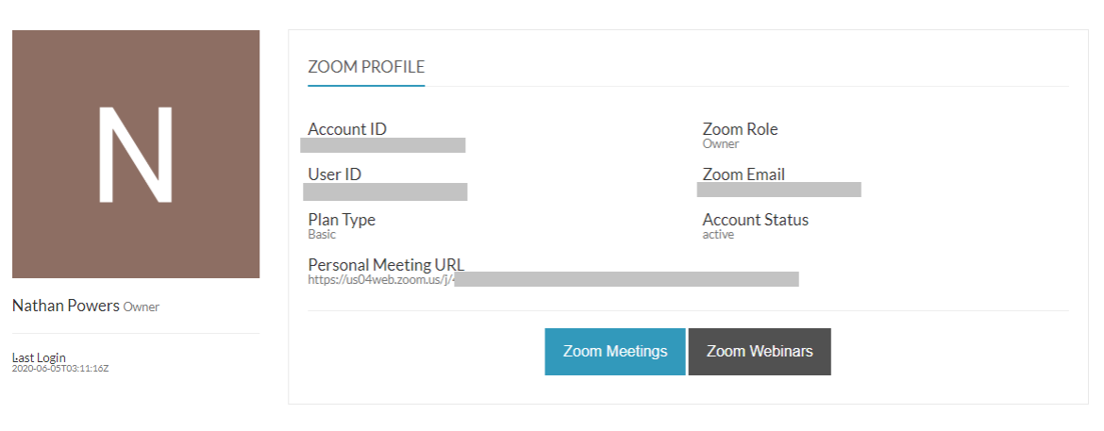
Zoom Profile
Here you will see a partial version of your profile as it appears in Zoom. From here, you can click Zoom Meetings or Zoom Webinars if your account is capable of creating webinars.
Click
Zoom Meetings

Slide 6
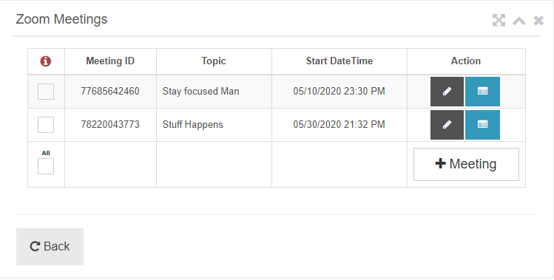
Zoom Meetings
If you have created any meetings, you will see them here. You can view or edit an existing meeting or you can create a new meeting. You can also delete a meeting entirely or you can simply hide a meeting from being visible in SimpleVLE
Click
the + Meeting Button

Slide 7
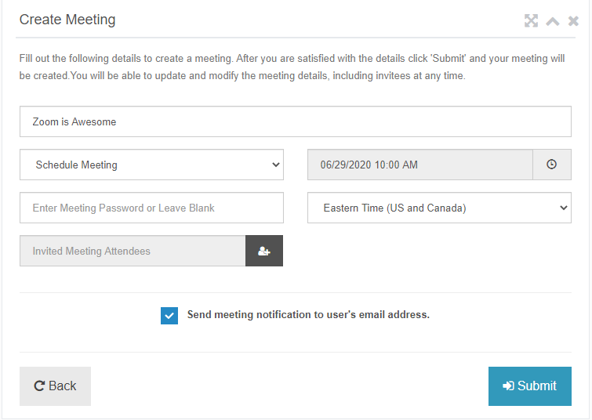
Create new
Meeting
When you create a meeting in SimpleVLE, you will be able to view and edit the meeting from both Zoom and SimpleVLE. Some options that available in Zoom may not be configurable in SimpleVLE. Send us a feedback if you want an option added. Otherwise you can edit the meeting directly in Zoom.
Click
the user icon button

Slide 8
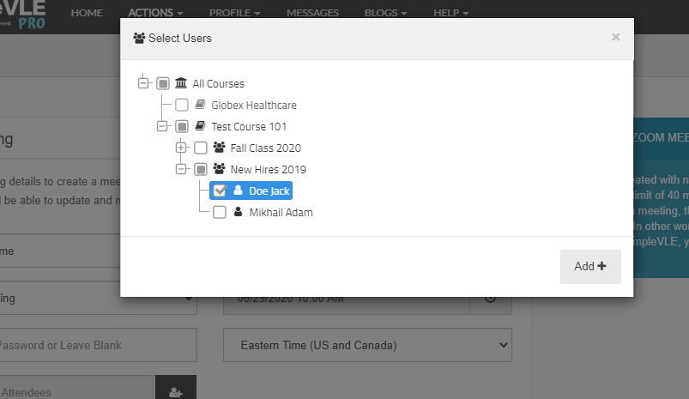
Inviting
Students
The main advantage to creating meetings with SimpleVLE is being able to invite your students. Here, you can select a single course, class, or student or you can select multiple courses, classes, or students.
Select
the students you wish to invite

Slide 9
Inviting
Students
Whether scheduling a meeting in the future or starting the meeting now, the students you invited will see the meeting when they log into their SimpleVLE account. You also have the option to send the invitees an email with the meeting details.
Click
Submit to create the meeting

Slide 10
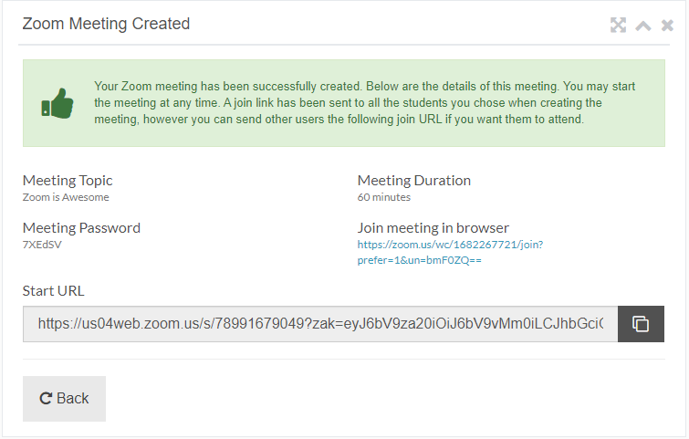
Meeting
Created
Once you have created the meeting you will be able to view the start URL, meeting password, and other meeting properties. You can always return to this screen to retrieve those properties at any time.
Click
back to return to meetings

Slide 11
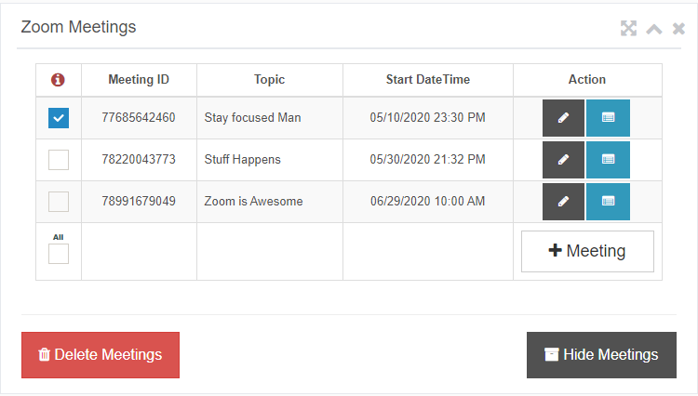
Hide or Delete Meetings
If you wish to hide a meeting or delete a meeting entirely, click the checkbox beside one or more meetings that you with to hide or delete. Then click one of the Hide or Delete Meetings button.
Click
Hide Meetings or Delete Meetings

Slide 12
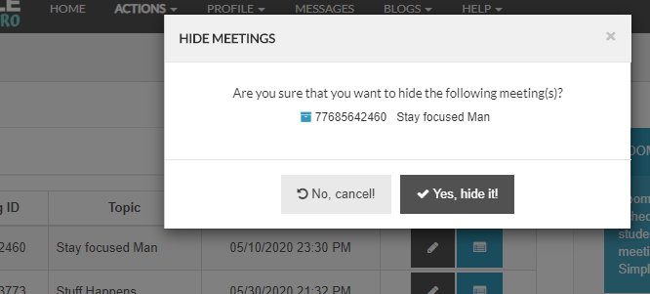
Hide or Delete Meetings
A confirmation modal will appear to verify that you really want to hide or delete the meeting. In this example, we are only hiding the meeting so that it wont be visible in SimpleVLE anymore. However, the meeting still exists in Zoom.
Click
Yes, hide it!

Slide 13
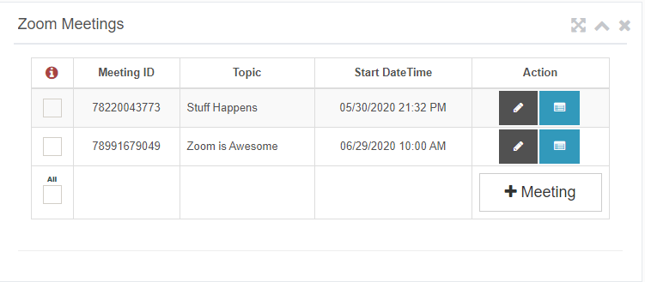
View/Start
Meeting
You can view and start your meeting from SimpleVLE. Click the blue list icon button adjacent to the meeting you wish to view or start
Click
the blue list icon button

Slide 14
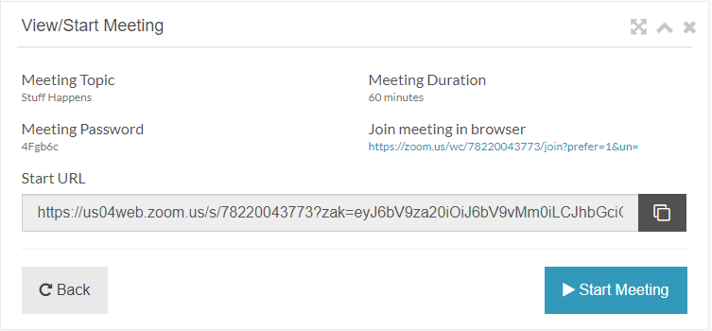
Start
Meeting
You can start your meeting by clicking the Start Meeting button or you can copy the URL and start using it.
Click
Start meeting

Slide 15
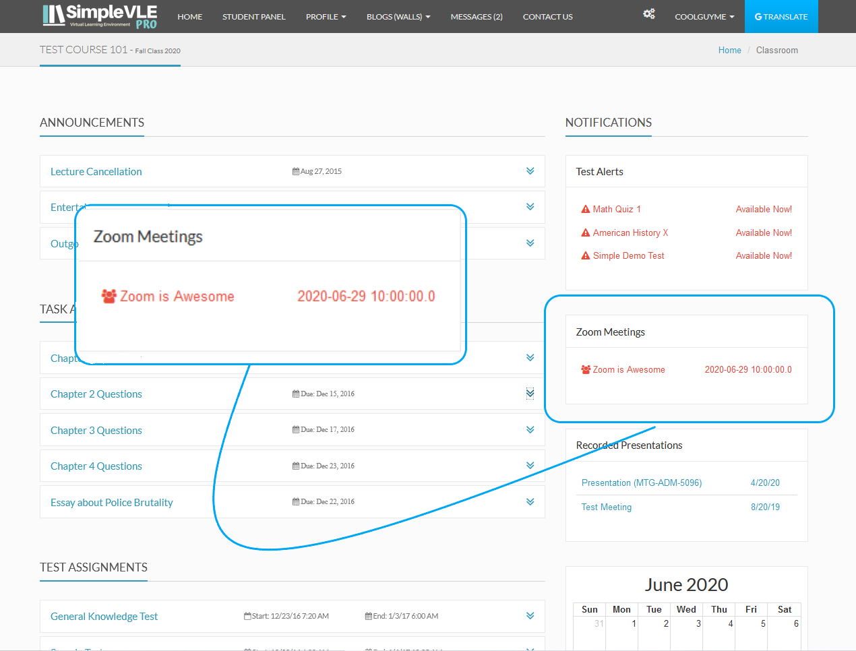
Student
Perspective
Here is what the student will see when he or she has been invited to a Zoom meeting when they log into SimpleVLE. If the meeting is ongoing, they will be able to join. If the meeting is scheduled for later, they will see a date and time for when the meeting is scheduled to start.
Click
Meeting Link

Slide 16
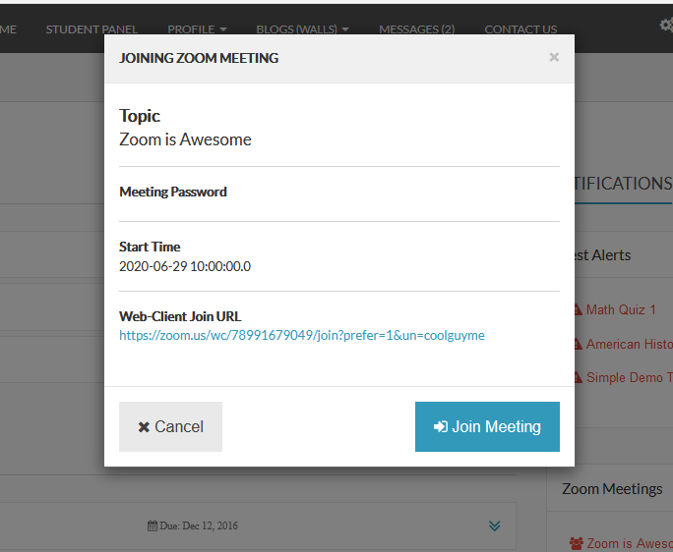
Student
Joining Meeting
After clicking the link, the student will be able to view the Meeting topic, start time, and password. If the meeting has started the student will be able to click the Join Meeting button for the download version or the Web-Client Join URL to join meeting in browser.

Slide 17
Uninstalling
In order to uninstall or deauthorize SimpleVLE from your Zoom Account, you must login to Zoom and do the following:
Navigate to Zoom App Marketplace
Click Manage > Installed Apps or Search for the SimpleVLE App.
Click the SimpleVLE App
Click Uninstall

Slide 18
Webinars
If your account includes a webinar plan, you will be able to create, view, edit, and invite students to your webinars the same way that we described for meetings.
SIMPLISTECH
Zoom Integration

Slide 19
Questions or Concerns
SIMPLISTECH
If you have any questions or concerns, please email us at support@simplevle.com or contact us here.
Zoom Integration

